Slide 1
Introduction to Machine Learning: A Practical Overview ( Training to Deployment)
Faculty Development Programme on
“Data Analytics using Python/R Programming”
Department of Computer Science and Engineering,
National Institute of Technology Puducherry, Karaikal
Sponsored by: AICTE Training and Learning Academy (ATAL)
Dr. Ajit Kumar
Post Doctoral Researcher,
Soongsil University, Seoul, South Korea

Slide 2
Contents
Machine Learning Algorithms
Training, Testing, Tuning
Deployment Modules
Data Collection to Deployment: Use-case
Question and Discussion

Slide 3
Machine Learning Algorithms
Supervised Learning
Unsupervised Learning
Reinforcement Learning

Slide 4
Supervised Learning
Decision Tree
Random forest
Naive Bayes
KNN
Logistic Regression
https://scikit-learn.org/stable/supervised_learning.html#supervised-learning

Slide 5
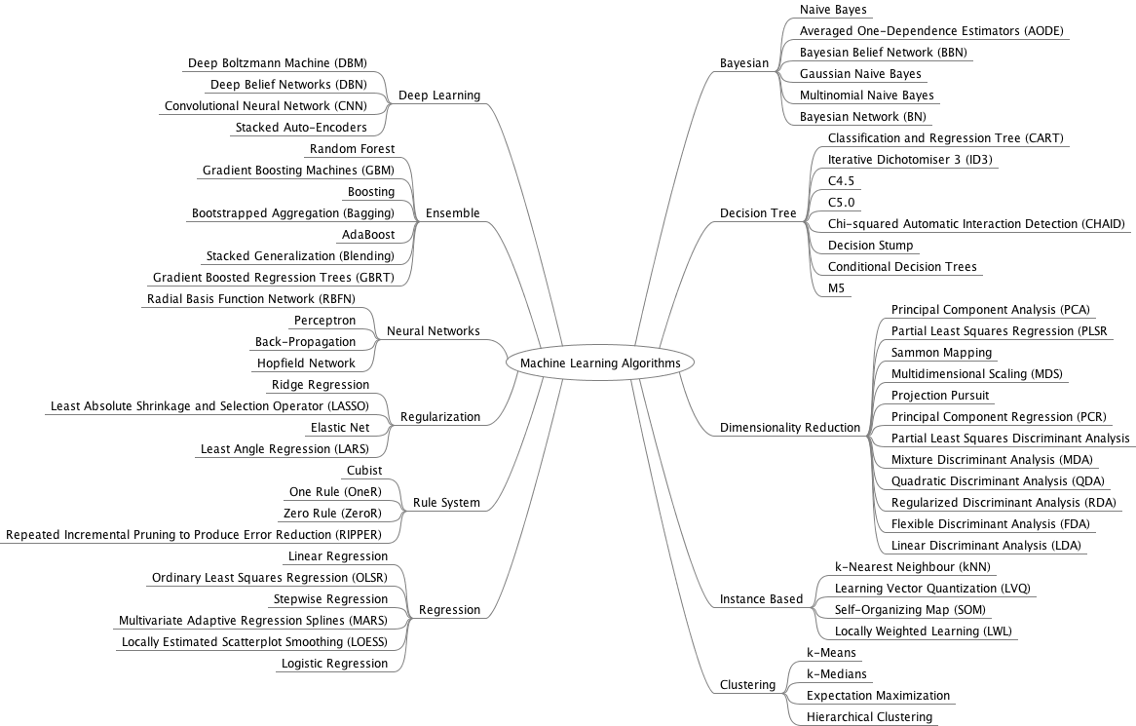
Supervised Learning
https://machinelearningmastery.com/a-tour-of-machine-learning-algorithms/

Slide 6
Training, Testing, Tuning
Training and testing dataset
(manual split vs cross-validation)
Overfitting
https://scikit-learn.org/stable/modules/cross_validation.html
Training, testing and Validation dataset
Performance Evaluation:
Accuracy, Confusion Matrix, Precision, Recall, F1-Score, ROC, AUC
Hyper-parameter (evaluating different settings) Tuning
(Grid Search)

Slide 7

Cross-validation
k-fold CV, the training set is split into k smaller sets
A model is trained using k-1 of the folds as training data;
the resulting model is validated on the remaining part of the data (i.e., it is used as a test set to compute a performance measure such as accuracy).

Slide 8
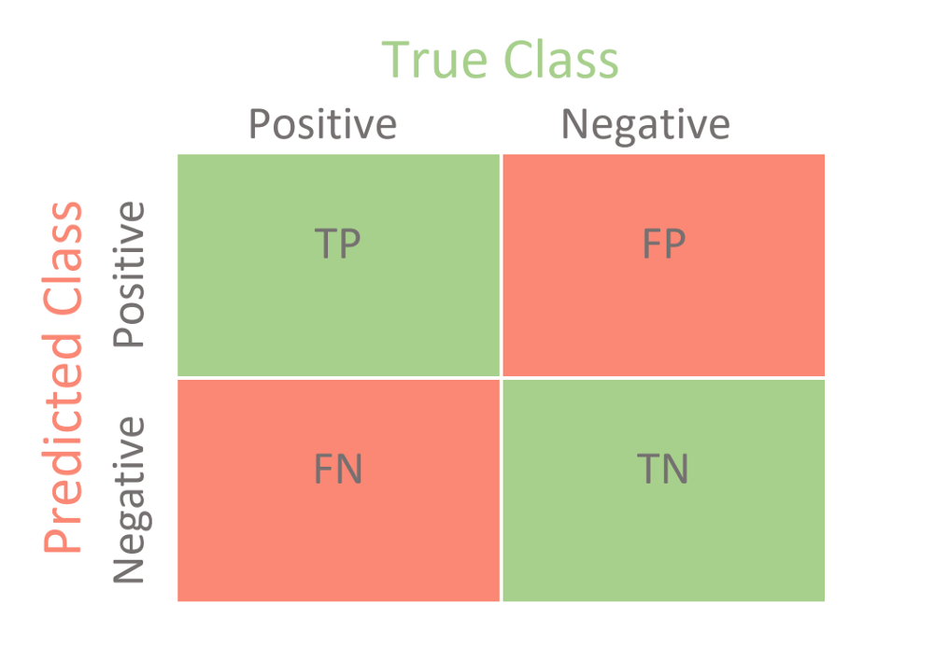
Performance Evaluation
Accuracy: number of correct predictions / total predictions
Confusion Matrix:
True Positive (TP):
Positive sample classified as Positive
False Positive (FP):
Negative sample classified as Positive
False Negative (FN):
Positive sample classified as Negative
True Negative (TN):
Negative sample classified as Negative

Slide 9
Performance Evaluation
Precision:ratio between the number of True Positives and the total number of Positives
TP/ (TP+FP)
Recall/Sensitivity/TPR:a ratio between true positive and the total number of positive instances
TP/ (TP+FN)
F1-Score:harmonic mean of precision and recall i.e. 2 /(1/precision + 1/recall)
Receiver operating characteristic (ROC):
plots the true positive rate (TPR)of a classifier against its false positive rate (FPR).
AUC: Area Under the curve
Source:
https://scikit-learn.org/stable/modules/model_evaluation.html
https://towardsdatascience.com/a-practical-guide-to-seven-essential-performance-metrics-for-classification-using-scikit-learn-2de0e0a8a040

Slide 10
Hyper-parameter tuning
https://scikit-learn.org/stable/modules/grid_search.html
A search consists of:
an estimator (regressor or classifier such as sklearn.svm.SVC());
a parameter space(GridSearchCV vs RandomizedSearchCV)
a method for searching or sampling candidates;
a cross-validation scheme; and
a score function.

Slide 11
Feature Selection
Removing features with low variance
Univariate feature selection
Recursive feature elimination
Feature selection using SelectFromModel
Sequential Feature Selection
Feature selection as part of a pipeline
https://scikit-learn.org/stable/modules/feature_selection.html#feature-selection

Slide 12
Deployment Modules
Making model persistent
Saving and Loading models
API/ Web /Mobile interface

Slide 13
Use-case : Malware detection Web application
Malware sample collection
Pre-processing
Feature extraction
Training, testing, Persistent
Deployment

Slide 14
Unsupervised Learning
Clustering of unlabeled data can be performed with the module sklearn.cluster.
Partitioning methods, Hierarchical methods,Density-based methods
Kmeans
DBSCAN
Meanshift
https://scikit-learn.org/stable/modules/clustering.html#clustering
Homogeneity score, completeness score vs silhouette score

Slide 15
Reinforcement Learning
Q-learning
Pyqlearning
KerasRL
Tensorforce
RL_Coach
MushroomRL

